Slide 1
Creating Websites with R & Hugo
library(dplyr)
rladies_global %>%
filter(city == ’Charlottesville')
February 22, 2018
Notes:
Welcome!
Intros
Agenda:
1 – brief overview of creating a website with R (intro to Rmarkdown, blogdown, Hugo)
2 – unveiling of Rladies Cville website
3 – next steps

Slide 2
Announcements
RLadies DC is hosting Hadley Wickham tomorrow Feb 23rd
New Meetup: Charlottesville Women in Machine Learning and Data Science – kickoff Tues March 6th at Random Row
Apply to be a Civic Innovation Day Project Fellow with Smart Cville: https://www.smartcville.com/cid-project-fellows/
Cville Open Data Challenge launches Thurs March 1st
Cville Women in Data Science Conference Friday March 16th – catch Marieke and Samantha

Slide 3
1.
Where to begin?
Let’s start with the basics
Notes:
Actually, before I begin, let me ask: how many of you have created a website? What did you use? What was that experience like?
HTML, CSS, Rmarkdown, Blogdown, Wordpress, Pandocs, Hugo, GitHub, Netlify - it can all seem a little overwhelming
Let’s start by defining some of our tools

Slide 4

R Markdown
A file format for making dynamic, fully reproducible documents with R. It combines the core syntax of markdown with embedded R code chunks that are run so their output can be included in the final document.
An RMD document is first compiled to Markdown through knitr which executes all program code in the document. Then the Markdown output document is compiled to the final output document through Pandoc, such as an HTML page, a PDF document, a Word document, and so on.
Notes:
TLDR; Rmarkdown is a file format for making reproducible code and it does some work under the hood to make that code reproducible by rendering it in html, pdf, etc.

Slide 5
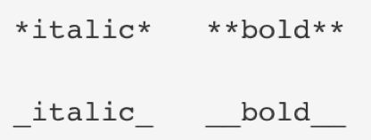
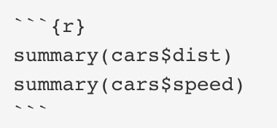
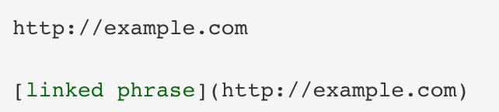
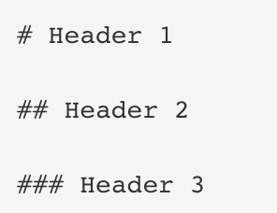
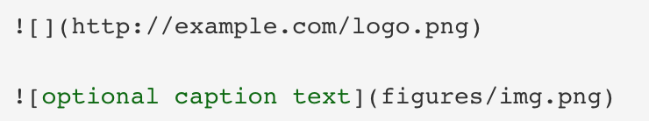
R Markdown Basics
Emphasis:
Code Chunks:
Links:
Headings:
Images:
Shameless plug alert! Anyone want to lead an RMD workshop???
Notes:
For images, Images on the web or local files in the same directory

Slide 6

Hugo
Hugo is a static site generator - unlike systems that dynamically build a page with each visitor request, Hugo builds pages when you create or update your content.
Can be hosted nearly anywhere (GitHub, Netlify, Amazon S3, etc.)
File directory > databases (less code!)
Creates a template for you to build off of
See all themes at: https://themes.gohugo.io/
Installed using blogdown
Notes:
Static - Since websites are viewed far more often than they are edited, Hugo is designed to provide an optimal viewing experience for your website’s end users and an ideal writing experience for website authors.
Can run without the need for a database or dependencies on expensive runtimes (i.e. less code!)
Hugo takes a source directory of files and templates and uses them as input to create a complete website
Written in Go
.

Slide 7
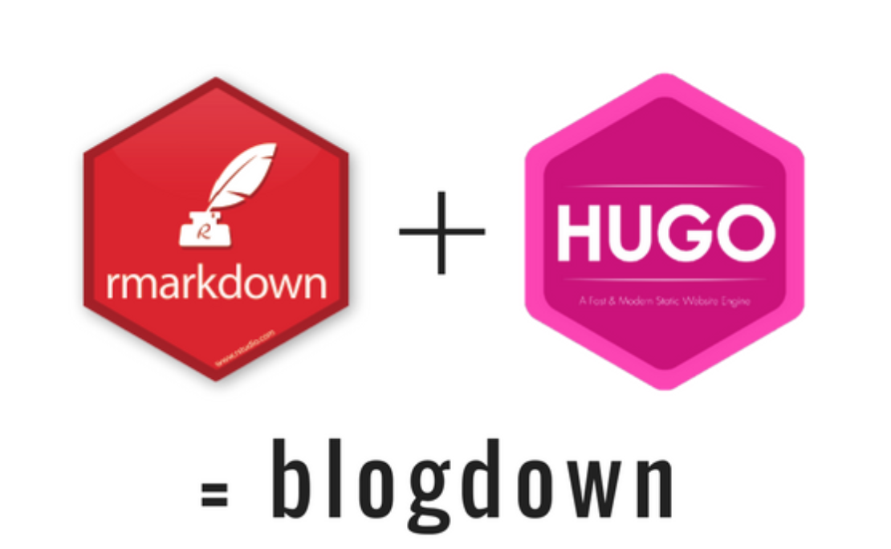
Blogdown
An R package for creating websites using Rmarkdown and Hugo

Slide 8
Blogdown
Since the help docs for blogdown can be a little daunting, let’s take a step back and look at an overview of the workflow:
Start:
Pick a Hugo theme
Create a new project in Rstudio and implement the theme
Play around with your content – the config.toml file is a good starting point
Edit:
Use ”Serve Site” addin to preview
Use “New Post” addin to create a new page, then start writing content
Use “Update Metadata” addin to modify YAML
Publish:
Create a separate repo on GitHub with all the files for your website
Log onto Netlify with your GitHub account
Push the repo to Netlify for continuous deployment
Notes:
Start your website:
1 - Carefully pick a theme at http://themes.gohugo.io, and find the link to its GitHub repository, which is of the form https://github.com/user/repo.
2 - Create a new project in RStudio, and type the code blogdown::new_site(theme = 'user/repo')in the R console, where user/repo is from the link in Step 1.
3 - Play with the new site for a while and if you do not like it, you can repeat the above steps, otherwise edit the options in config.toml. If you do not understand certain options, go to the documentation of the theme, which is often the README page of the GitHub repository. Not all options have to be changed.
Note TOML: is made up of key=value pairs it’s good for editing global things like links, etc.
Edit your website:
1 - Click the RStudio addin “Serve Site” to preview the site in RStudio Viewer. This only needs to be done once every time you open the RStudio project or restart your R session. Do not click the Knit button on the RStudio toolbar.
2 - Use the “New Post” addin to create a new post or page, then start writing the content.
3 - Use the “Update Metadata” addin to modify the YAML metadata if necessary.
Note: YAML is for author, date, categories, tags, etc. – used in content section
Publish:
1 - Restart the R session, and run blogdown::hugo_build(). You should get a public/ directory under the root directory of your project.
Log into https://www.netlify.com (you can use a GitHub account if you have one). If this is the first time you have published this website, you can create a new site, otherwise you may update the existing site you created last time. You can drag and drop the public/ folder from your file viewer to the indicated area on the Netlify web page, where it says “Drag a folder with a static site here.”
Wait for a few seconds for Netlify to deploy the files, and it will assign a random subdomain of the form random-word-12345.netlify.com to you. You can (and should) change this random subdomain to a more meaningful one if it is still available.
It can be much easier to publish a website if you are familiar with GIT and GitHub. We recommend that you create a new site on Netlify from your GitHub repository that contains the source files of your website, so that you can enjoy the benefits of continuous deployment instead of manually uploading the public/ folder every time. With this approach, you do not need to run blogdown::hugo_build()locally, because the website can be built on Netlify via Hugo.

Slide 9
2.
Launching the Rladies Cville Website
Click here to view!

Slide 10
3.
How can we make it better
Let’s dive a little deeper…
Notes:
What does this website need?
Rladies logo
About as landing page – posts to link to meetup events
Bio section?
Media section
Icons with font awesome

Slide 11
Key takeaways
It ain’t easy – the best way to learn is to play around, crash some sites, and then build new ones
Simplicity is key
Directories > databases
Don’t try to reinvent the wheel with widgets and colors: pick your Hugo theme carefully!

Slide 12
Pick your Hugo theme carefully

Slide 13
Additional resources
Peter Baumgartner’s Blogdown Tutorial
Alison Hill’s Portland R UseR’s Meetup presentation
Yihui Xie’s Bookdown on Blogdown
Selection of Hugo themes: https://themes.gohugo.io/
Thank you!!

